Slide 1

Executive Sales Dashboard – Superstore Dataset
AnalystLab Africa Data Analytics Internship
Week 4 – Data Visualization & Dashboarding
Presented by:
Damilola Owolabi
Tool: Microsoft Power BI
Dataset: Superstore Sales Dataset (Kaggle)
July 2026

Slide 2
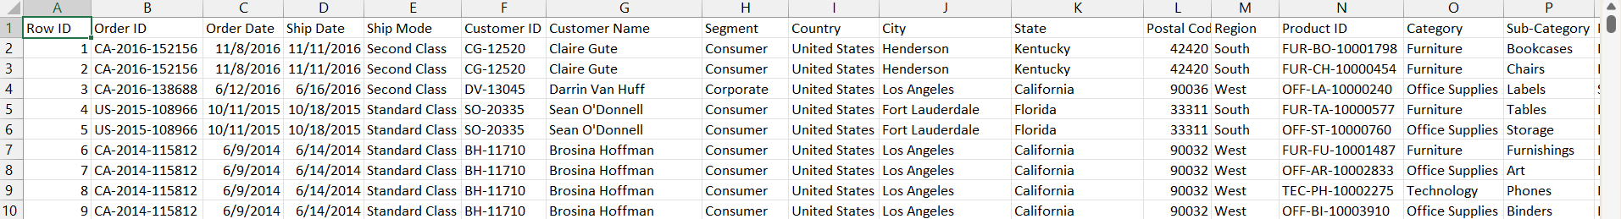
Dataset Overview
Dataset
• Superstore Sales Dataset
Source
• Kaggle
Tool
• Microsoft Power BI
Project Objective
• Analyze sales performance
• Identify business trends
• Build an interactive sales dashboard
• Support data-driven decision making

Slide 3
Business Problem
The Superstore management needs a dashboard that can:
• Monitor overall sales and profit performance
• Identify top-performing products and categories
• Compare sales across different regions
• Track monthly sales trends
• Support data-driven business decisions

Slide 4
KPIs Defined
KPI | Purpose
Total Sales | Shows the total revenue generated.
Total Profit | Measures overall business profit.
Total Orders | Shows the number of orders processed.
Profit Margin | Indicates how much profit was made from sales.

Slide 5
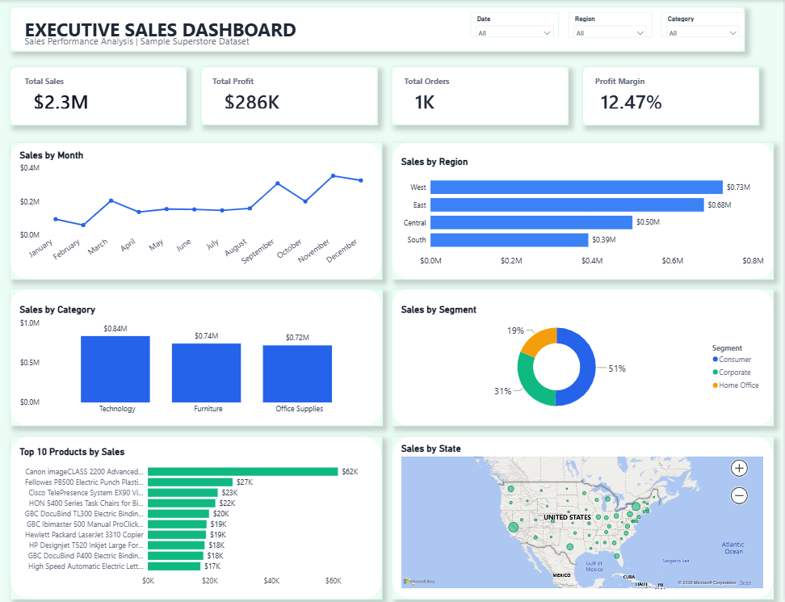
Executive Sales Dashboard

Slide 6
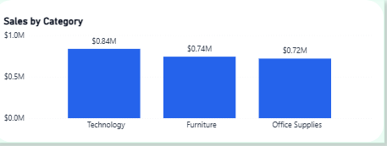
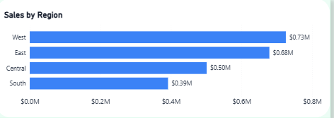
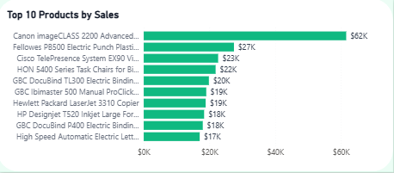
Key Insights
• Technology generated the highest sales among all product categories.
• The Consumer segment contributed the largest share of total sales.
• The West region recorded the highest sales performance.
• Sales were stronger towards the end of the year.
• Canon imageCLASS 2200 Advanced Copier was the top-selling product.

Slide 7
Recommendations
• Increase investment in the Technology category to maintain strong sales performance.
• Develop strategies to improve sales in lower-performing regions.
• Plan promotions and inventory ahead of the peak sales period towards the end of the year.
• Continue focusing on the Consumer segment while exploring opportunities to grow Corporate and Home Office sales.
• Monitor the performance of top-selling products and ensure adequate stock availability.

Slide 8
Challenges Faced
• Choosing the most suitable visuals for different business questions.
• Arranging the dashboard layout to improve readability.
• Formatting charts and KPI cards for a consistent design.
• Selecting colours that improve clarity without making the dashboard look crowded.
• Building an interactive dashboard using slicers and visual interactions.

Slide 9
Conclusion
This project transformed raw sales data into an interactive Power BI dashboard that highlights key business performance indicators.
The dashboard provides a clear view of sales trends, regional performance, customer segments, and product performance, helping decision-makers identify opportunities and make informed business decisions.

